Slide 1
System Analysis and Design on Institute of Information & Communication Technology, CUET
Submitted By :
Shafiul Alam (1904006) Md. Akib Hasan (1904015)
K.M Mahabub Hossain (1904017)
Sadman Rahman Ananta (1904020)
Sawmik Kumar Paul (1904021)
Supervised By:
Prof. Dr. Kaushik Deb Professor,
Dept of CSE, CUET Sabiha Anan Assistant Professor,
Dept of CSE, CUET
1
Notes:
1
*

Slide 2
Contents
Introduction
System Development Life Cycle (SDLC)
Context Diagram
Logical Data Flow Diagram
Physical Data Flow Diagram
Validate the Data Flow Diagram
Conclusion

Slide 3
Introduction
Specify flow of records
Provide a high-level overview of system functionality
Show mechanism how data is input, processed & outputted

Slide 4
System Development Life Cycle (SDLC)
Steps of SDLC:
1. Requirements Determinations
2. Requirements Specifications
3. Feasibility Analysis
4. Final Specifications
5. Hardware Study
6. System Design

Slide 5
System Development Life Cycle (SDLC)(Contd...)
7. System Implementation
8. System Evaluation
9. System Modification

Slide 6
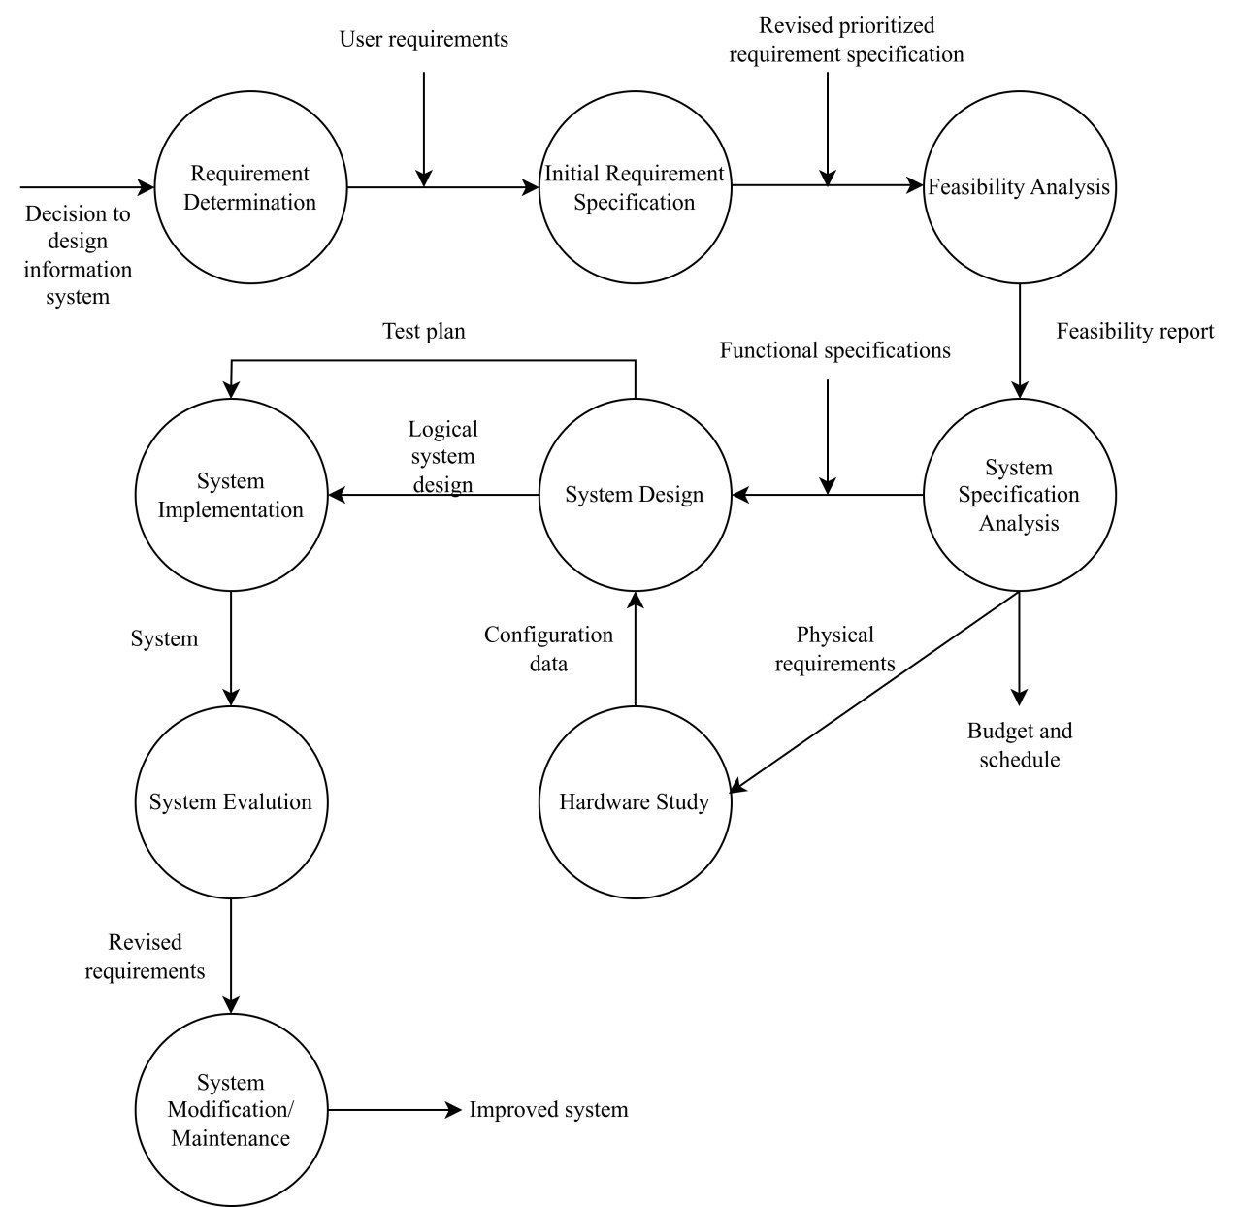
System Development Life Cycle(SDLC)(Contd.)
Figure 1 : SDLC

Slide 7
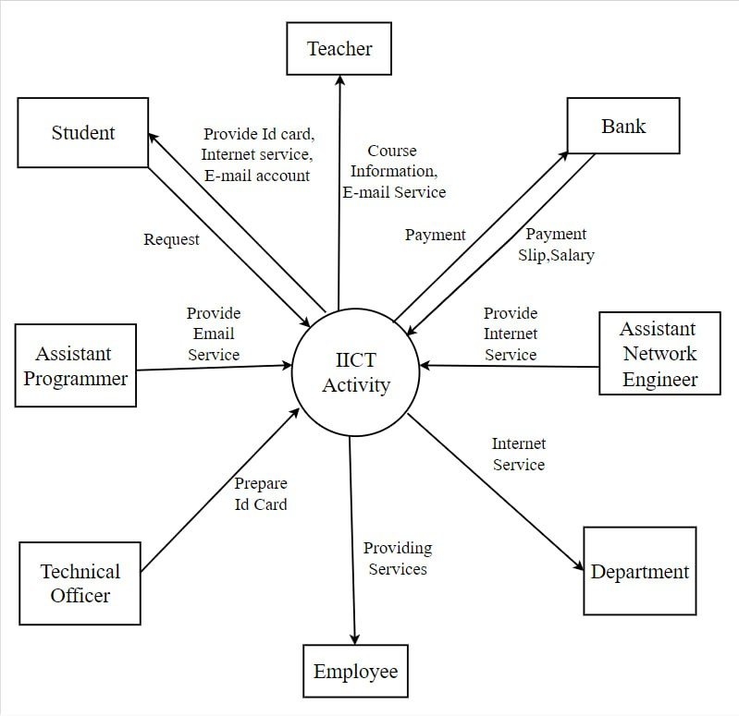
Data Flow Diagram
Figure 2 : Context Diagram

Slide 8
Data Flow Diagram(Contd.)
Two types-
(i) Logical Data Flow Diagram
(ii) Physical Data Flow Diagram

Slide 9
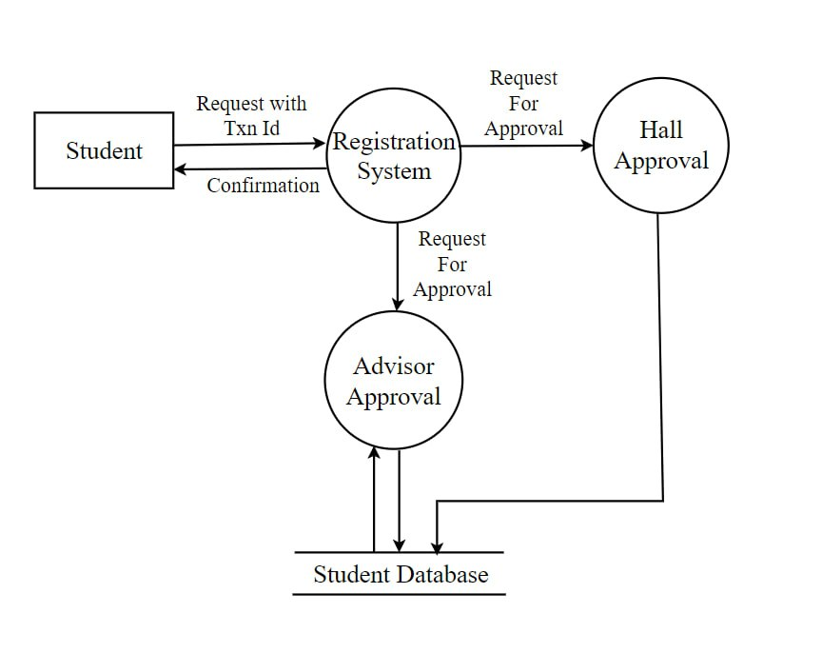
Logical Data Flow Diagram
Figure 3 : Logical DFD of Course Registration

Slide 10
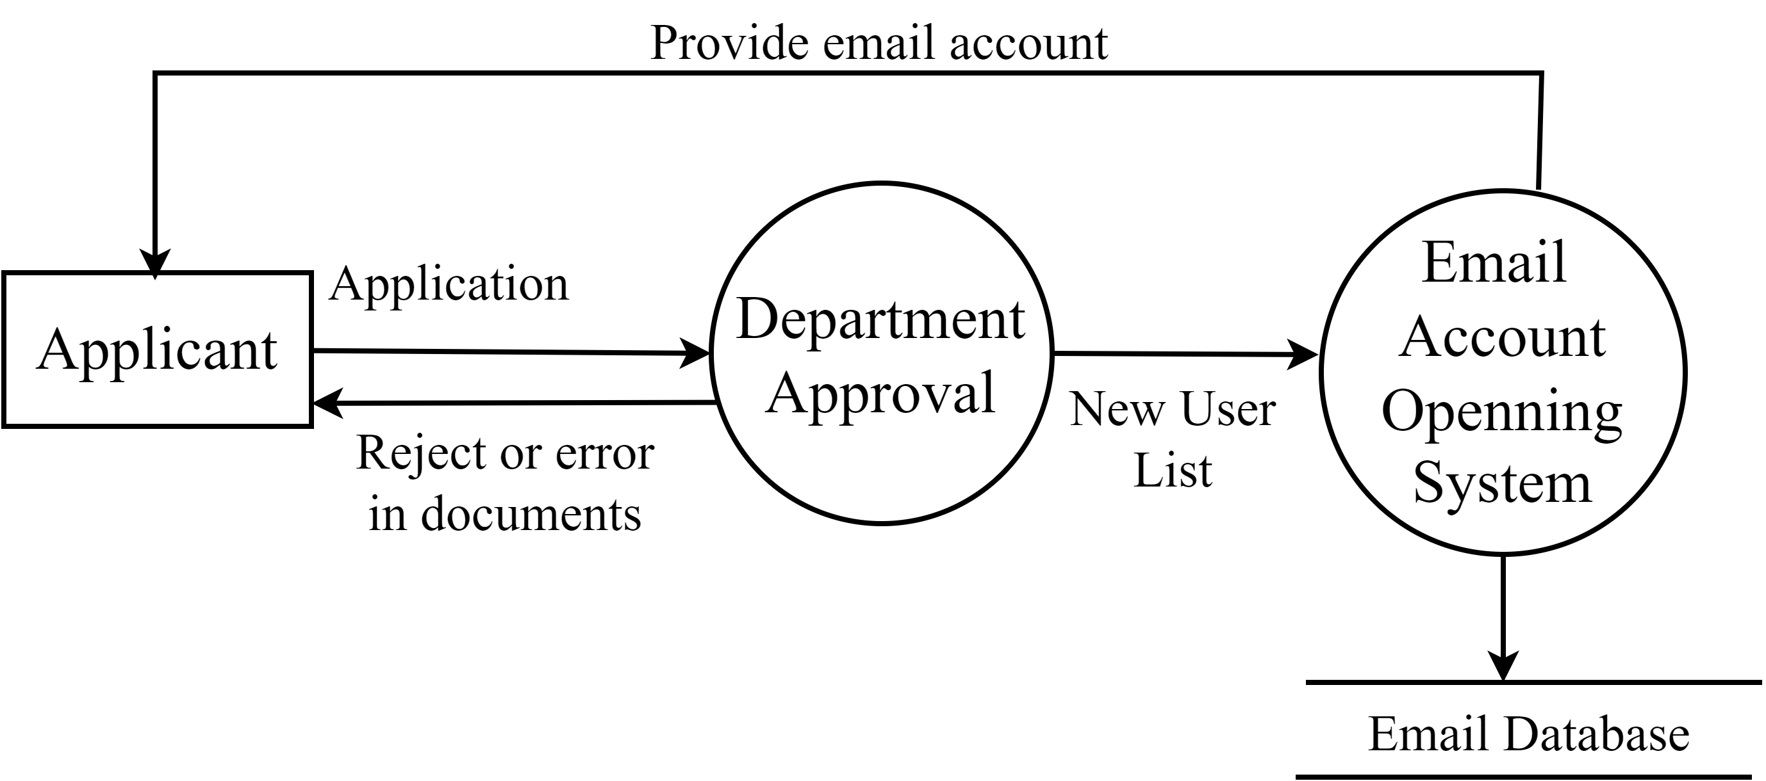
Logical Data Flow Diagram (Contd…)
Figure 4: Logical DFD of opening E-mail Account

Slide 11
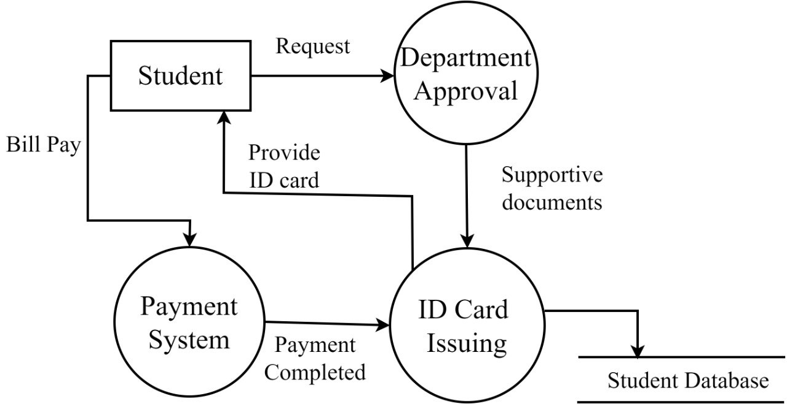
Logical Data Flow Diagram (Contd…)
Figure 5: Logical DFD of ID Card Issuing

Slide 12
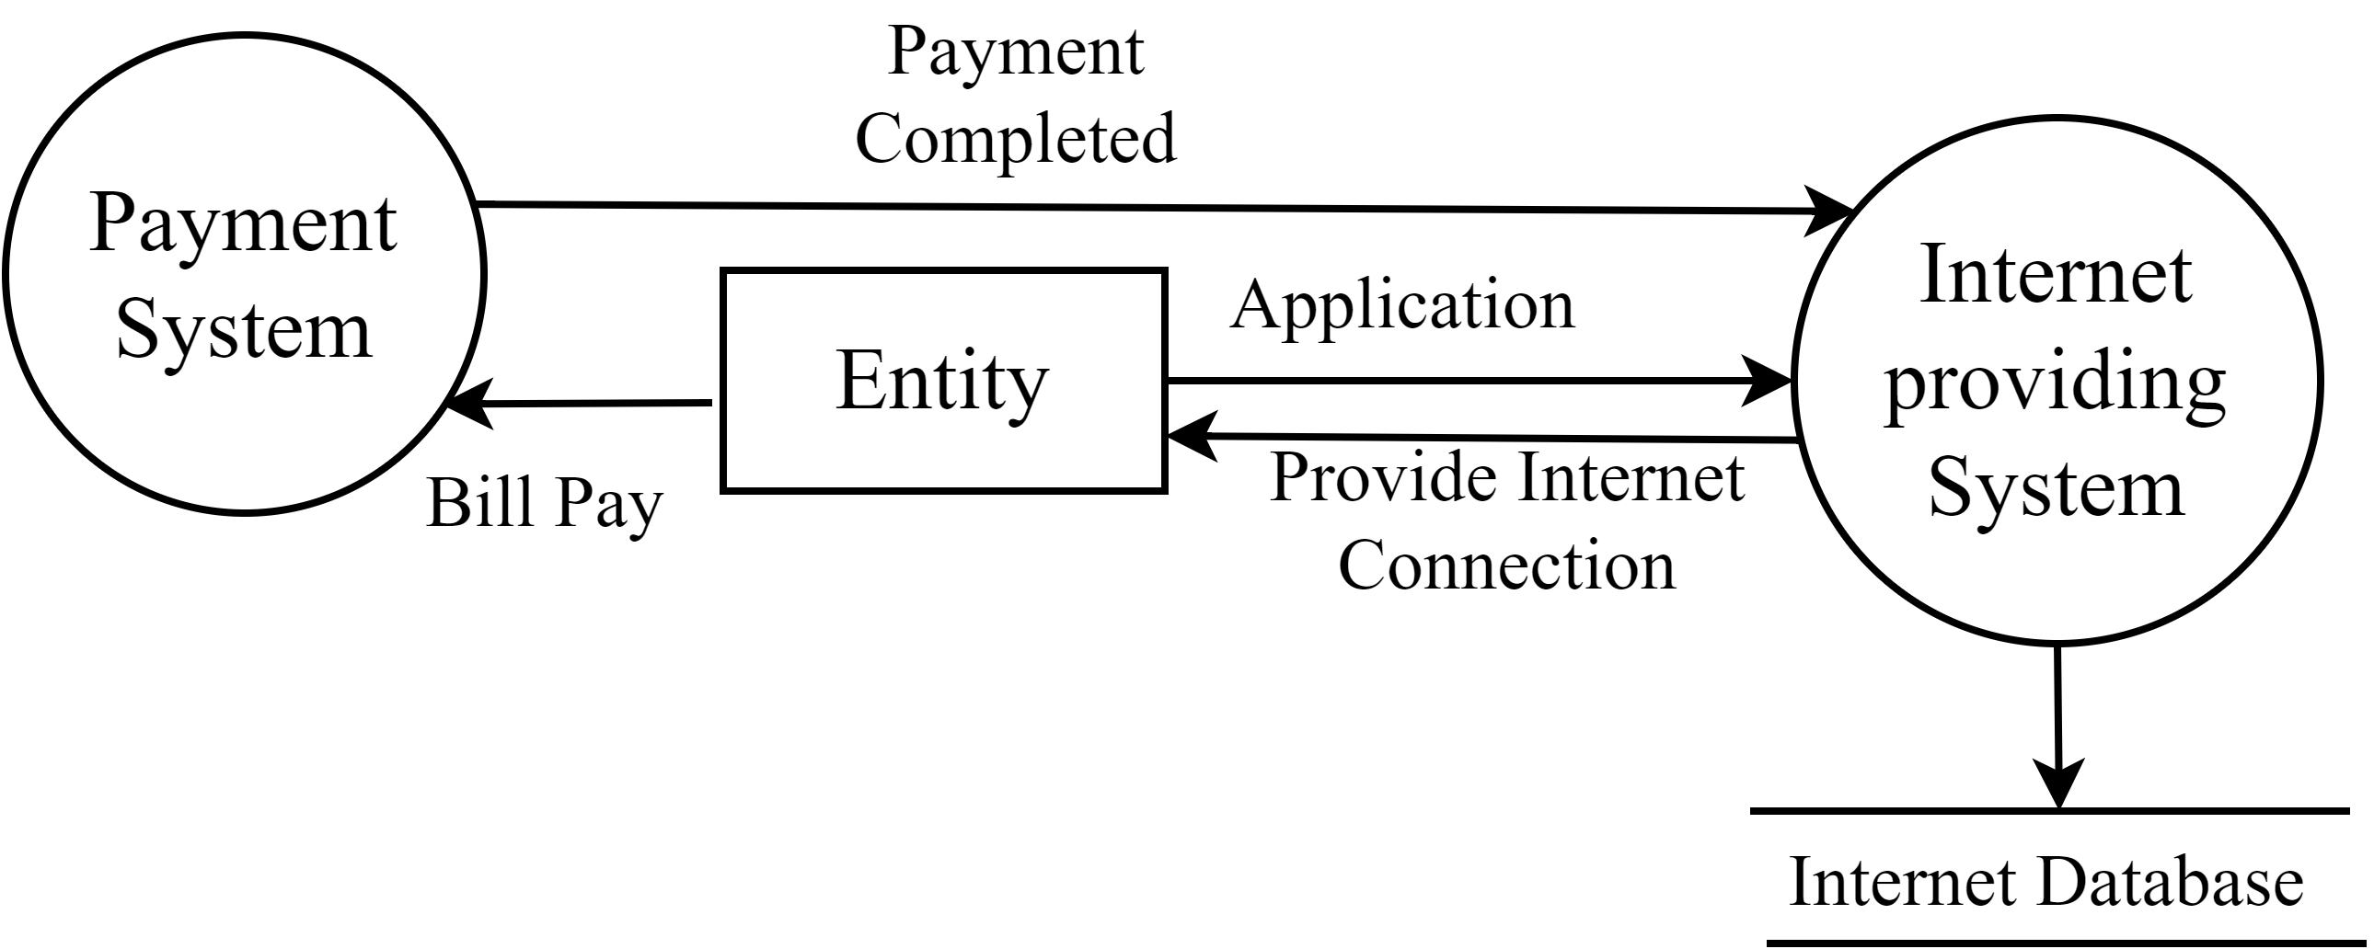
Logical Data Flow Diagram (Contd…)
Figure 6: Logical DFD of Internet Providing System

Slide 13
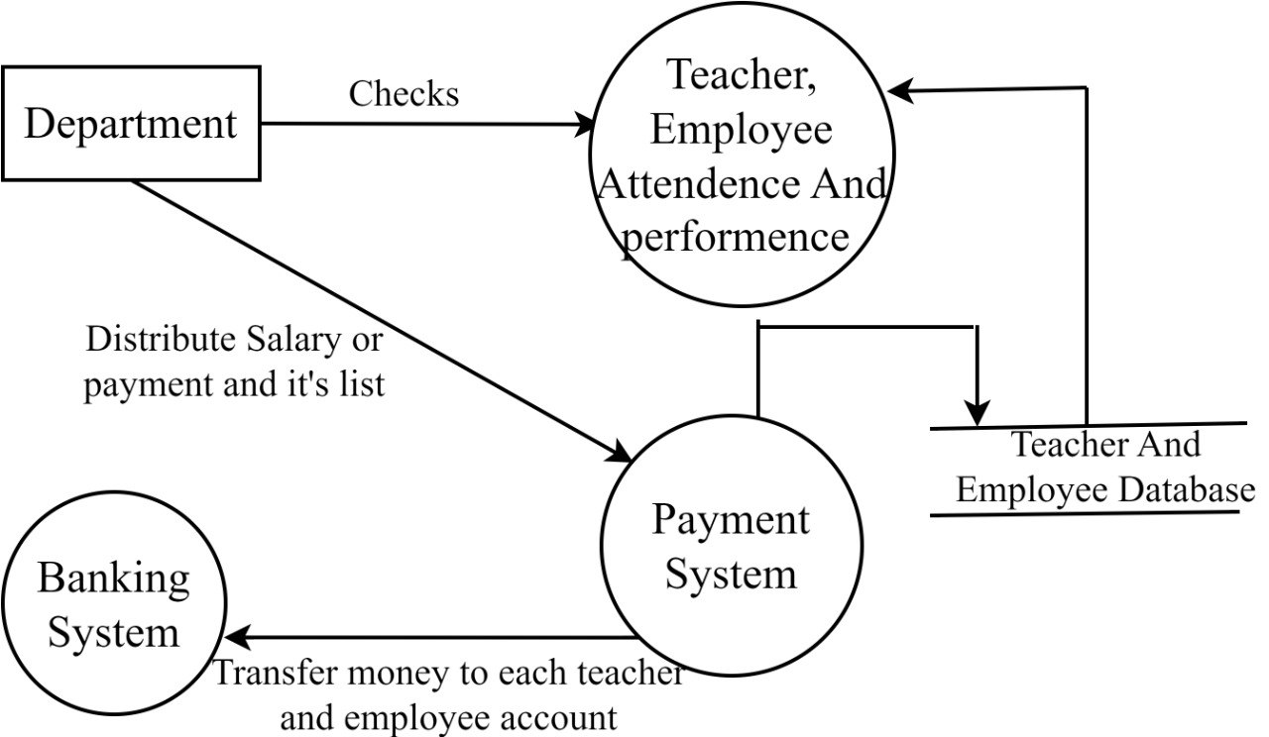
Logical Data Flow Diagram (Contd…)
Figure 7: Logical DFD of Online Payment System

Slide 14
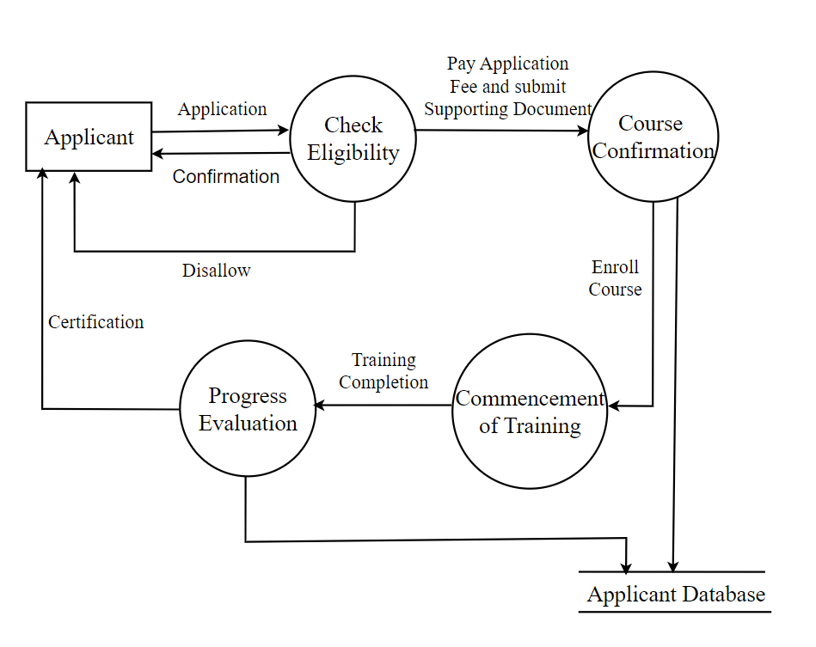
Logical Data Flow Diagram (Contd…)
Figure 8: Logical DFD of Technical Course Offering

Slide 15
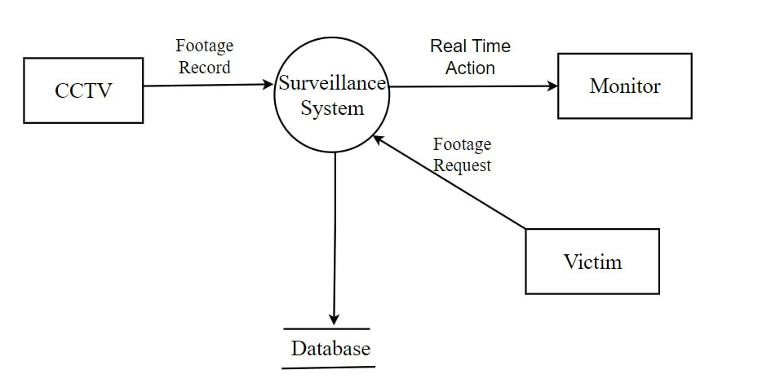
Logical Data Flow Diagram (Contd…)
Figure 9: Logical DFD of Surveillance System

Slide 16
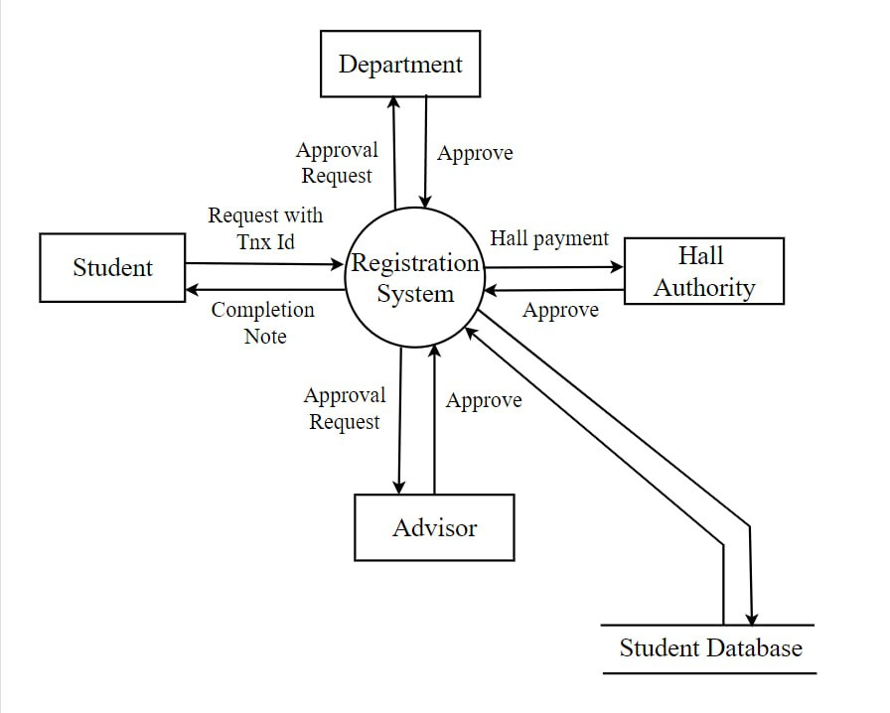
Physical Data Flow Diagram
Figure 10: Physical DFD of Course Registration

Slide 17
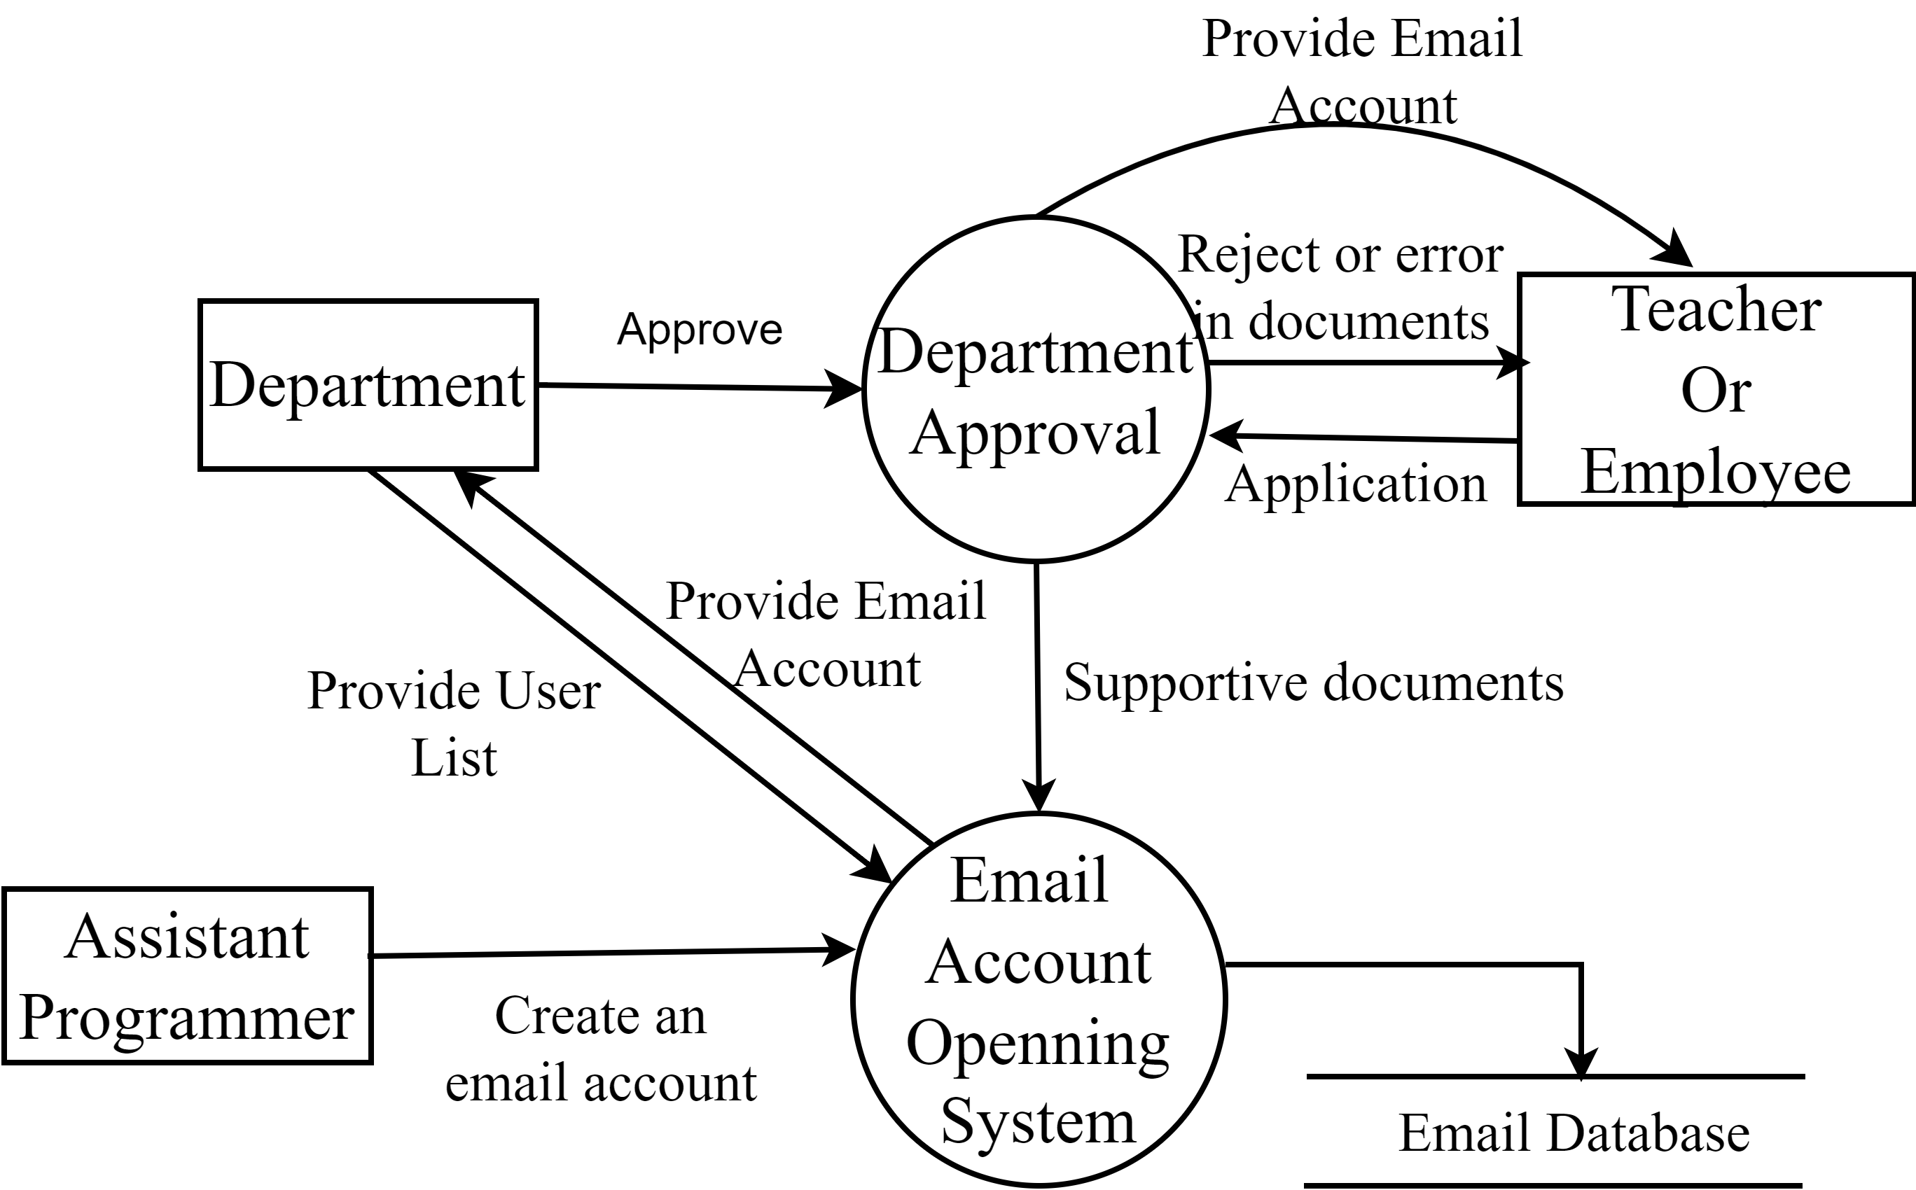
Physical Data Flow Diagram (Contd…)
Figure 11: Physical DFD of opening E-mail Account

Slide 18
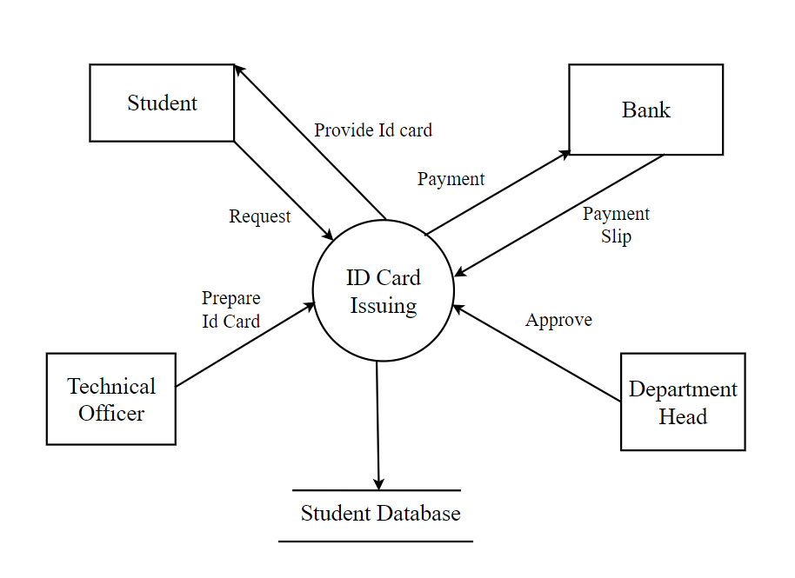
Physical Data Flow Diagram (Contd…)
Figure 12: Physical DFD of ID Card Issuing

Slide 19
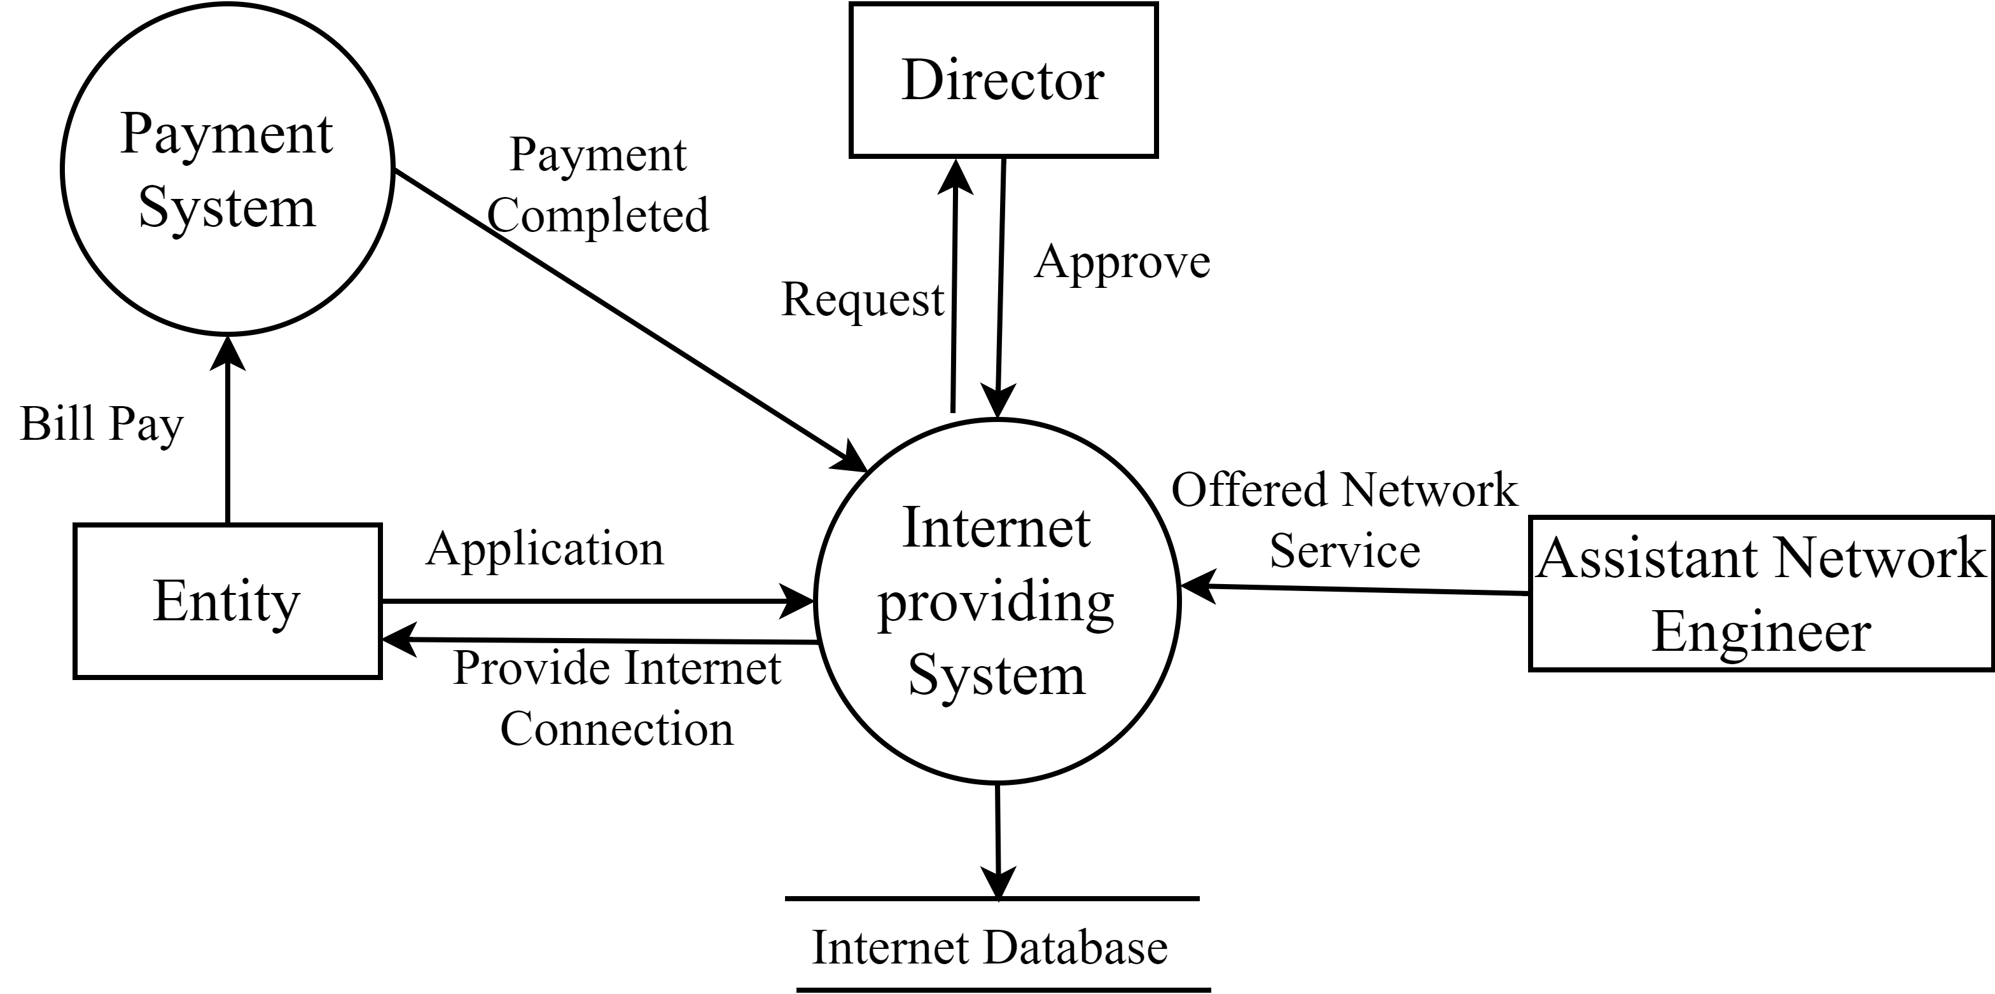
Physical Data Flow Diagram (Contd…)
Figure 13: Physical DFD of Internet Providing System

Slide 20
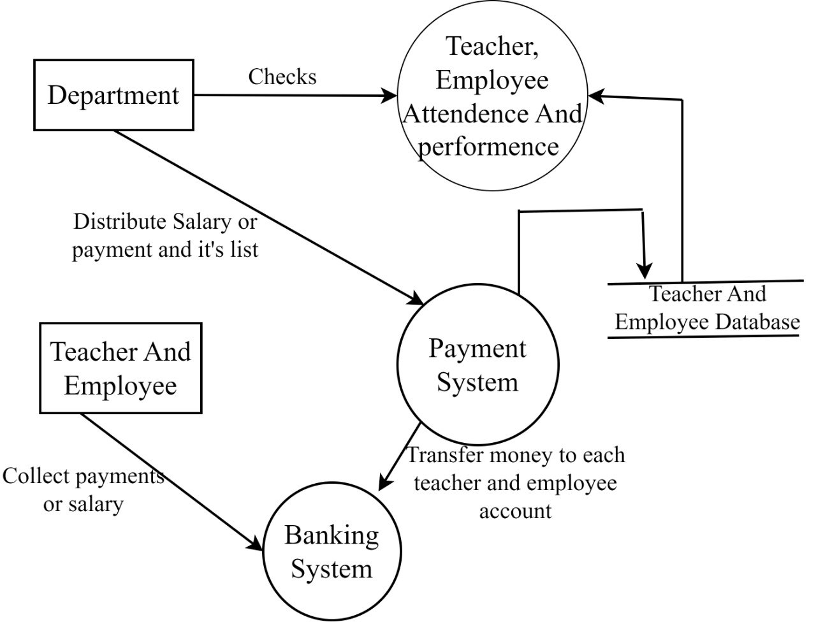
Physical Data Flow Diagram (Contd…)
Figure 14: Physical DFD of Online Payment System

Slide 21
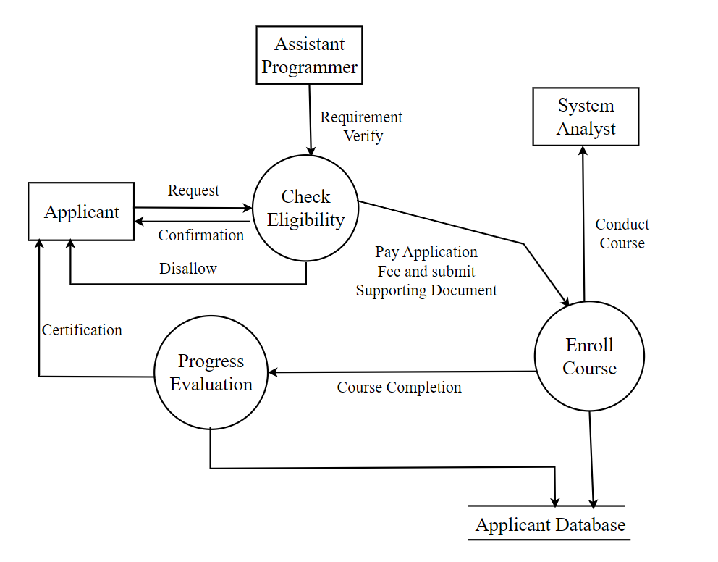
Physical Data Flow Diagram (Contd…)
Figure 15: Physical DFD of Technical Course Offering

Slide 22
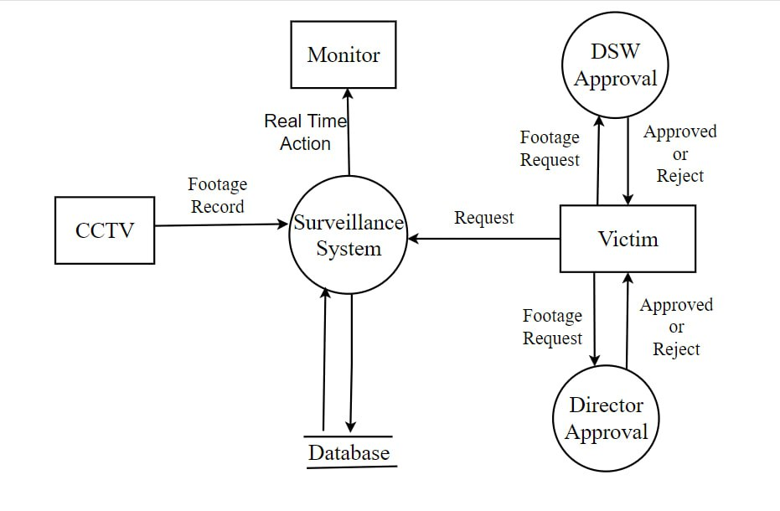
Physical Data Flow Diagram (Contd…)
Figure 16: Physical DFD of Surveillance System

Slide 23
Validate the Data Flow Diagram
Data can flow from:
(i) Process to Process
(ii) Process to Store and Back
(iii) Process to External entity
(iv) External entity to Process

Slide 24
Validate the Data Flow Diagram (Contd…)
Data cannot flow from:
(i) Store to Store
(ii) Store to External entity
(iii) External entity to Store
(iv) External entity to External entity

Slide 25
Validate the Data Flow Diagram (Contd…)
Illegal Constructs in DFD :
(i) No loops are allowed in DFD
(ii) A single data flow should not be divided into many flows with different labels
(iii) No data flow allowed between data stores
(iv) A process cannot be pure decision

Slide 26
Conclusion
Faced some difficulties in collecting flow of data
Consumed a bit time to draw the logical & physical data flow diagram
Understood how logical & physical data flow over the system

Slide 27


